Slide 1


Preventing Network Attacks using Support Vector Machine and Software Defined Networking (SDN) Integration
Department of Information Technology
V R Siddhartha Engineering College
Network Security, Cyber Security
and Information Security
B.Tech in Information Technology
Mini Project 2 Review Presentation
Presented by
Mr. Dinakar Laxmi Viswanath (208W1A1201)
Mr. Sotsava Skandhaa (208W1A1202)
Under the guidance of
S. Kranthi , Assistant professor

Slide 2
AGENDA
Problem Statement
Objectives of the Project
Outcomes of the Project
Literature Review and Summary
Dataset and Requirements
Architecture diagram
Implementation Steps
Algorithm
Results

Slide 3
PROBLEM DEFINITION
The increasing number of cyber-attacks on networks has become a major concern for organizations and individuals. Traditional security solutions, such as firewalls and intrusion detection systems, are becoming less effective in defending against these attacks. This project aims to address this problem by using a deep learning model-based solution for detecting and preventing DDOS network attacks in a software-defined networking (SDN) environment. The solution uses a trained linear Support Vector Machine (SVM) algorithm model to control the behavior of one or more SDN controllers to prevent attacks.

Slide 4
OBJECTIVES
To develop an efficient machine learning model that can classify the given network traffic dataset to various attacks with maximum accuracy.
Using SDN controllers to stop traffic from a host based on its IP address.

Slide 5
OUTCOMES
Demonstrated the system's ability to detect and respond to network attacks in a controlled environment.
Reduced the false positive rate to 6% while maintaining a true positive rate of 93%.
The integration of machine learning with SDN controllers can lead to more adaptive and efficient network defenses.

Slide 6
LITERATURE SURVEY
Title of the Project | Authors | Methodology | Source | Summary
A Flow-Based Anomaly Detection Approach With Feature Selection Method Against DDoS Attacks in SDNs | Mahmoud Said El Sayed Nhien-An Le-Khac , Marianne A. Azer and Anca D. Jurcut (2020) | LSTM-Autoencoder | IEEE TRANSACTIONS ON COGNITIVE COMMUNICATIONS AND NETWORKING | Our approach provides a high detection rate and presents a more efficient better time to build the model. We further tested the trained model on the performance of the SDN controllers to evaluate how the used dataset can impact on the performance of the SDN controller. The results showed that the proposed approach does not deteriorate the network performance
Deep Neural Networks for Intrusion Detection in Software-Defined Networking | Wang et al. (2019) | Random Forests | IEEE (Institute of Electrical and Electronics Engineers) | The authors evaluate the performance of their proposed solution using both simulated and real-world network security datasets and show that deep neural networks can significantly improve the accuracy of intrusion detection in SDN environments.

Slide 7
Title of the Project | Authors | Methodology | Source | Summary
End-to-end intrusion detection in software-defined networks using deep reinforcement learning | Qin et al. (2019) | A K-mean clustering and random forest based multilevel model . | IEEE (Transactions on Network and Service Management) | The proposed solution can effectively detect various types of network attacks in real-time and provide a flexible and scalable solution for SDN security.
Anomaly-based Intrusion Detection in Software-Defined Networks: A Deep Learning Approach | Zhang et al. (2019) | Naïve Bayes classifier | IEEE Access | The proposed method uses an autoencoder to learn the normal behavior of the network and identify anomalies, which are then classified as either benign or malicious using a deep neural network.
Distributed abnormal behavior detection approach | Naila Marir HuiqiaWaGuangsheBingyang | DBN and SVM | IEEE, 2018 | DBN is used to extract SVM ensemble characteristics and to anticipate the voting process.

Slide 8
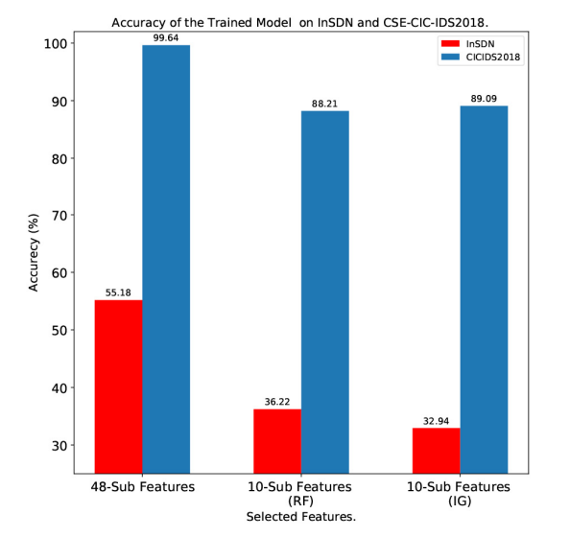
REVIEW PAPER : Mahmoud Said El Sayed Nhien-An Le-Khac , Marianne A. Azer and Anca D. Jurcut. "A Flow-Based Anomaly Detection Approach With Feature Selection Method Against DDoS Attacks in SDNs." In 2022 IEEE TRANSACTIONS ON COGNITIVE COMMUNICATIONS AND NETWORKING.
SUMMARY :

Slide 9
REVIEW PAPER : Mahmoud Said El Sayed Nhien-An Le-Khac , Marianne A. Azer and Anca D. Jurcut. "A Flow-Based Anomaly Detection Approach With Feature Selection Method Against DDoS Attacks in SDNs." In 2022 IEEE TRANSACTIONS ON COGNITIVE COMMUNICATIONS AND NETWORKING.
SUMMARY :
The aim of this work is to reduce the redundant or irrelevant features without any significant impact on the classification accuracy. We have selected 10 features out of available 48 features using two common feature selection methods IG and RF. The approach provides a high detection rate and presents a more efficient better time to build the model. We further tested the trained model on the performance of More Than One SDN controller to evaluate how the used dataset can impact on the performance of the SDN controller. The results showed that the proposed approach does not deteriorate the network performance.

Slide 10
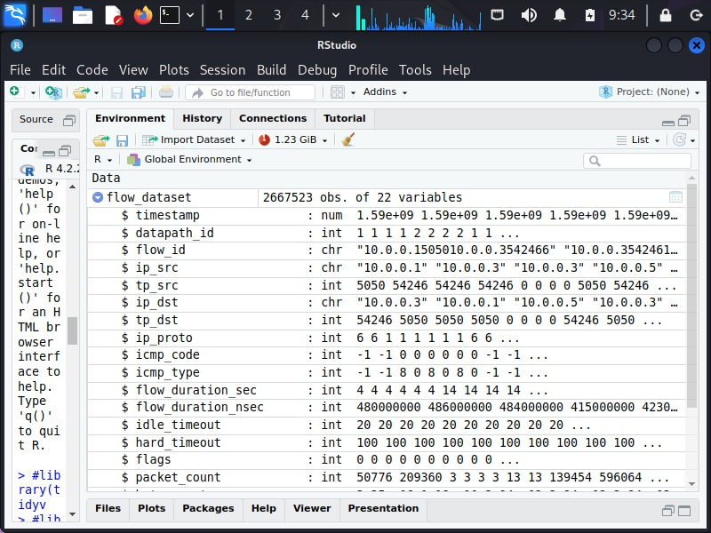
DATASET DESCRIPTION
We have a huge amount of data entries (2667523 Observations)
This is a snapshot of the sample data with column names.

Slide 11
REQUIREMENTS
User Interface:
This system's user interface is the Linux os, which is a user-friendly interface.
Hardware Interfaces:
Oracle Virtual Machine, Kali Linux, and Kaggle
Software Interfaces:
Required modules (tidyverse, e1071, caret, graphics, ggplot2, class, KNN, SVM)
Hardware Requirements:
Processor – Pentium-IV
RAM – 4GB (Minimum)
HDD/SSD – 256GB (Minimum)

Slide 12

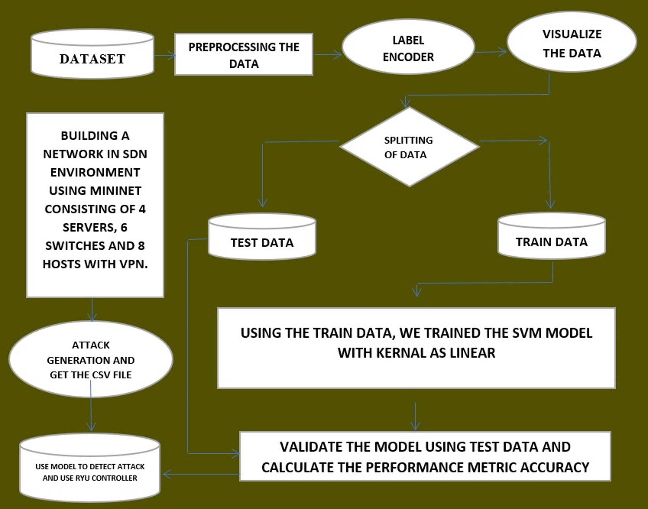
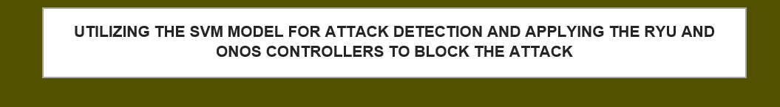
Architecture Diagram

Slide 13
IMPLEMENTATION STEPS
Machine Learning Model Development
Network Topology Setup
SDN Controller Setup
Integration of ML Model and SDN
Attack Generation
Decision and Action Logic
Results and Analysis

Slide 14
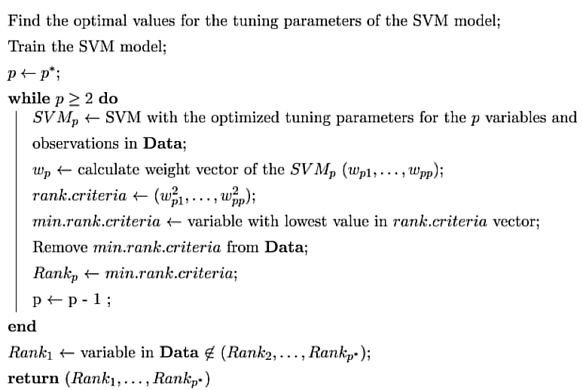
Algorithms
Algorithm Linear Support Vector Machine (SVM) :
Input: 02152020-threats-02-15-2020.csv Dataset
Output: Success Accuracy of SVM trained Model on test Data

Slide 15
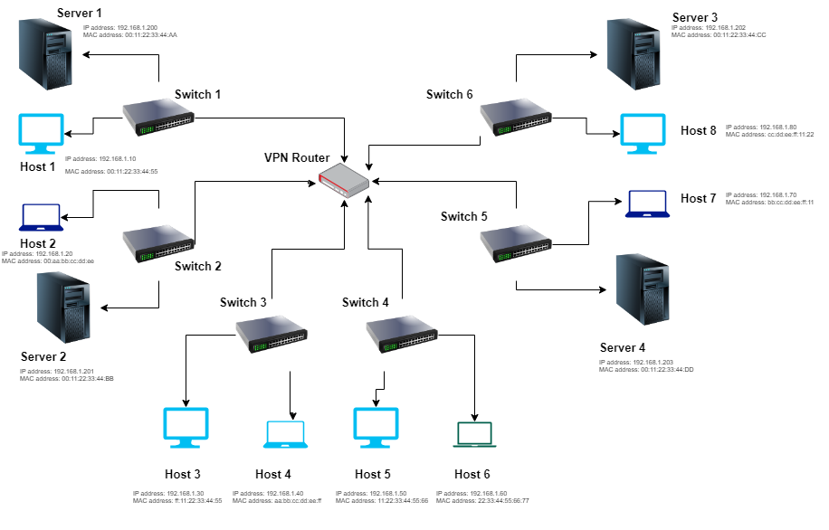
NETWORK TOPOLOGY
The above network is built using the Mininet to provide SDN environment

Slide 16
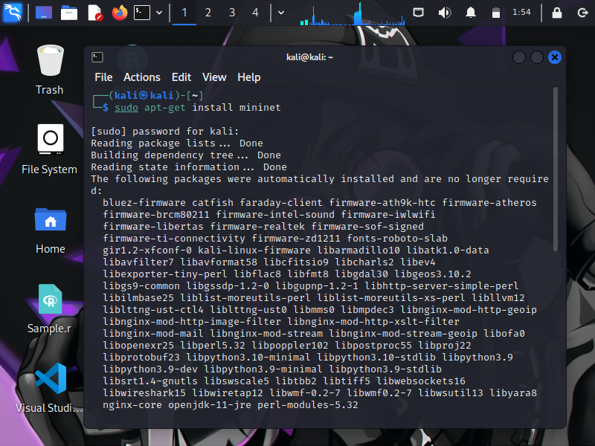
NETWORK USING MININET
from mininet.net import Mininet
from mininet.topo import Topo
from mininet.node import OVSSwitch, Controller
from mininet.cli import CLI
from mininet.link import TCLink
class MyTopology(Topo):
def __init__(self):
Topo.__init__(self)
# Add switches
switches = []
for i in range(6):
switch = self.addSwitch('s{}'.format(i+1), cls=OVSSwitch)
switches.append(switch)
# Add hosts
hosts = []
for i in range(8):
host = self.addHost('h{}'.format(i+1))
hosts.append(host)
# Add servers
servers = []
for i in range(4):
server = self.addHost('server{}'.format(i+1))
servers.append(server)
# Add links between switches and hosts
for i in range(len(hosts)):
switch = switches[i % len(switches)]
self.addLink(hosts[i], switch)
# Add links between switches and servers
for i in range(len(servers)):
switch = switches[i % len(switches)]
self.addLink(servers[i], switch)
# Add links between switches
for i in range(len(switches) - 1):
self.addLink(switches[i], switches[i+1])
topology = MyTopology()
# Create the Mininet network with the custom Ryu controller
net = Mininet(topo=topology, link=TCLink, controller=ryu_controller)
# Start the Mininet network
net.start()

Slide 17
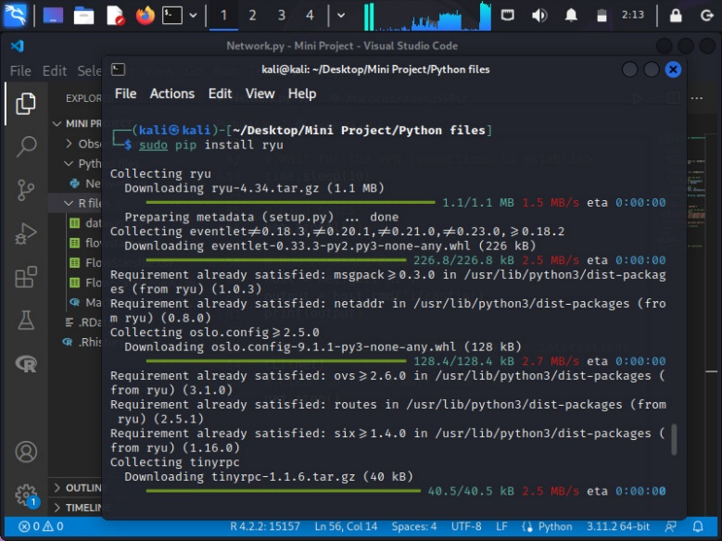
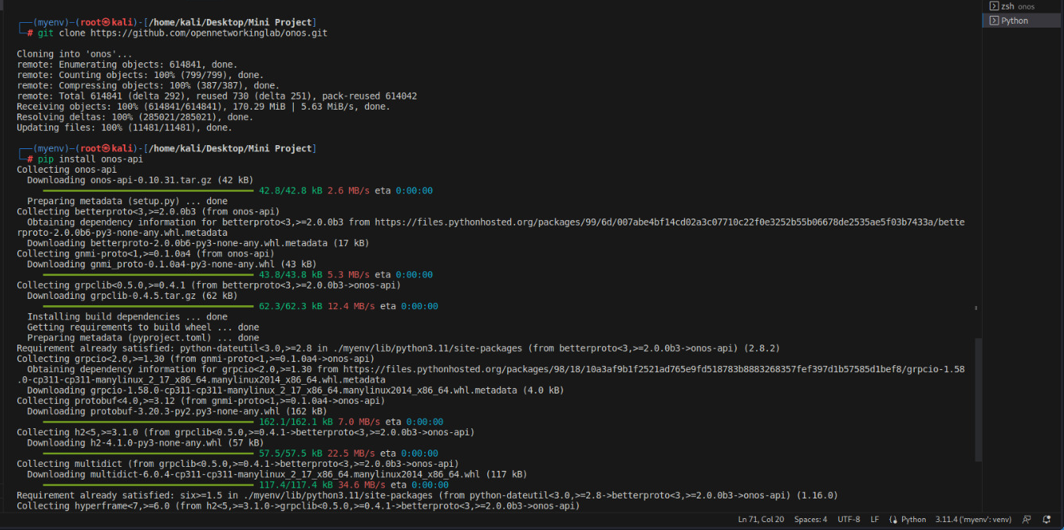
Controllers

Slide 18
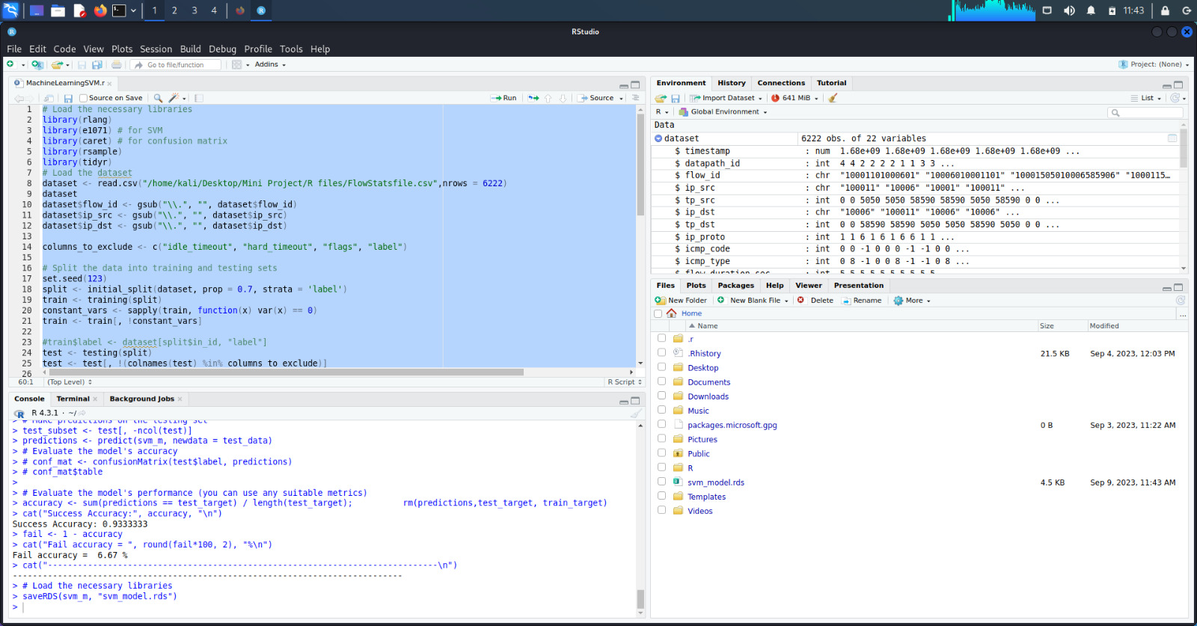
RESULTS
Linear SVM model Prediction Accuracy (R Studio)

Slide 19
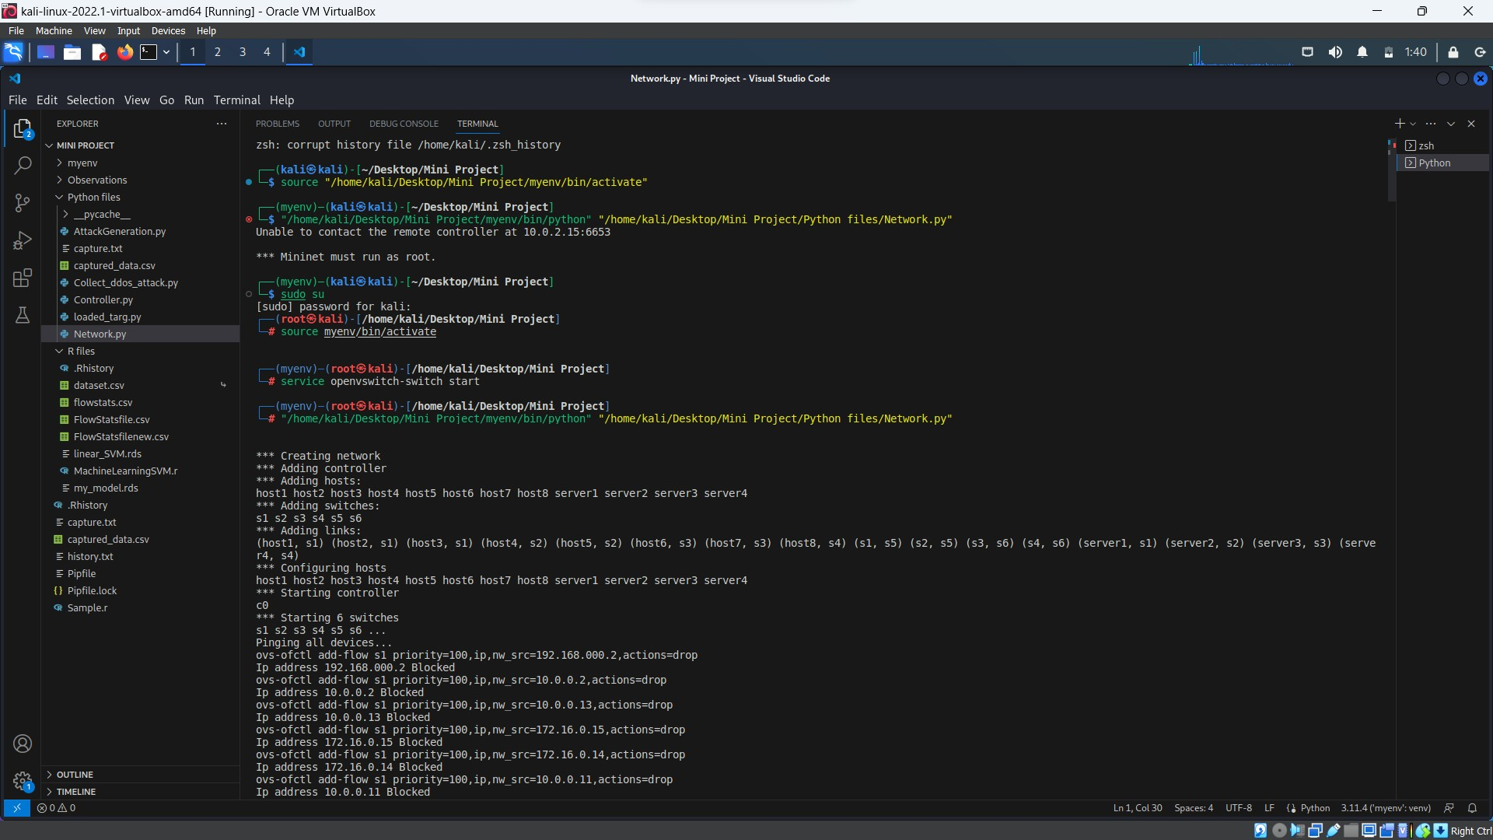
RESULTS
Ryu Controller and ONOS Controller Blocking the attacks (VS Code)

